Slide 1
Spring Final Design Review
Team 10 - David Balogh, Alexander Berman, Aidan Carter, Nick Duncan, Blake Gifford, Olivia Langley, Justin Simoneck, Justin Sayers, Emma Staib, Nicholas Weis, Olivia Wilson
Notes:
Justin

Slide 2
Project Definition & Goal:
Create half of a pill bottle-filling machine for project sponsors Norwalt and Omega Design which is made up of three separate subsystems that are each responsible for taking in and correctly orienting caps, securing caps to the bottles, and rejecting any bottles that are capped incorrectly.
The machine must also be able to receive bottles which have been filled with pills by a machine designed by any ‘Front-Station’ group.
There is a noticeable gap in the market for automated pill bottle producers. Smaller pill bottle producers need an automated system that is small and cheap.
The total time required for both the “Front” and “Back” station to complete one cycle must be at least 2 times as fast as a human would be filling a pill bottle.
Notes:
Justin

Slide 3
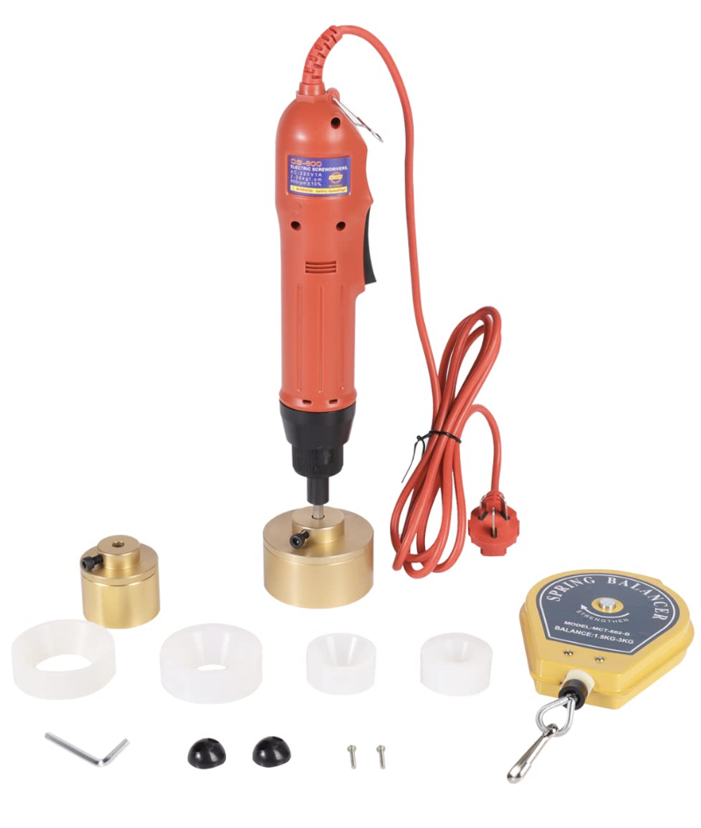
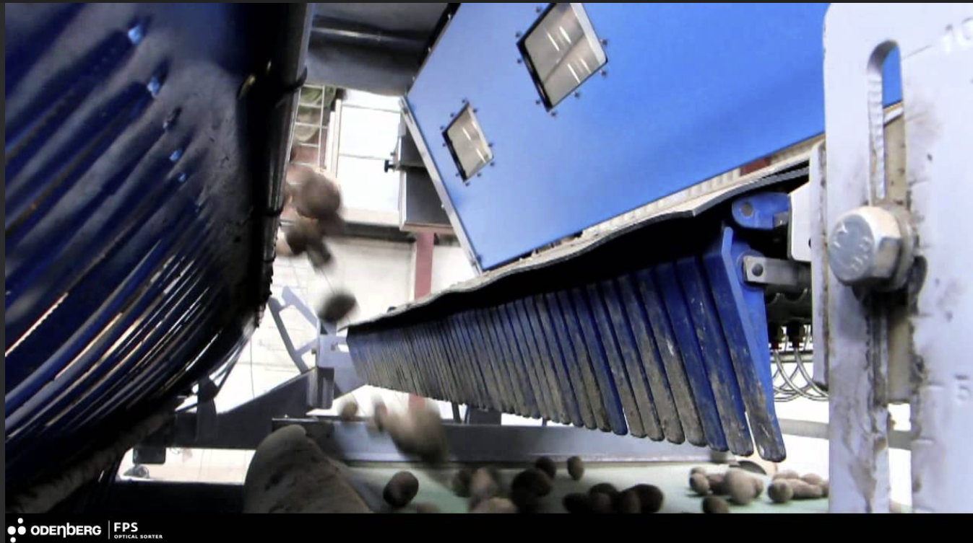
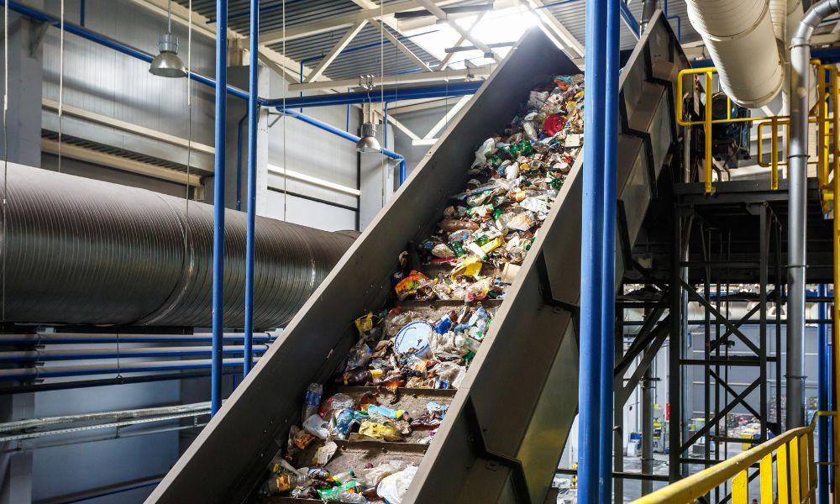
Background and Benchmarking
Descrambling
Capping
Rwe
Conveyance
Notes:
Justin

Slide 4
Table of Constraints
Want/ Constraint | Metric | Target Value | Justification
Bottle Handoff | # Bottles Collected successfully | 12 Bottles collected successfully | Project Definition and Sponsor [1]
Cap Descrambler | # Caps Descrambled successfully | 12 Caps successfully descrambled | Project Definition and Sponsor [1]
Capping | # Caps successfully capped | 12 Caps successfully capped | Project Definition and Sponsor [1]
Part Rejector | Must detect if cap is screwed on the bottle correctly, if not the bottle must be removed from the assembly line | No operator intervention is needed as well as must detect EVERY cap that is not screwed on properly | Project Definition and Sponsor [1]
 | Height of bottle | Cap must be within a certain range to not be rejected.
Automation | Must be fully automated | No operator intervention is needed while each station is functioning | Project Definition and Sponsor [1]
Speed of ‘Back Station’ Process | Time | 1/2X manual completion of process. | Project Definition and Sponsor [1]
Compact | Dimensions of all components when not in use | All materials fit in 26” x 20” x 40” storage area. | Project Definition and Sponsor [1]
Notes:
Olivia

Slide 5
Table of Wants
Priority | Want/ Constraint | Metric | Target Value | Justification
1 | Safety | OSHA Transport requirements | Fits within OSHA standards (29 CFR 1910.147,212,217) | Project Definition and Sponsor [1]
 |  | ISO and ASTM safety Standards | Fits within the given standards (ASTM E3106, etc.) | Project Definition and Sponsor [1]
2 | Pill Spillage | Number of pills leaving bottles during ‘Back Station’ process | Minimal error +/- 1 pill from nominal value | Project Definition and Sponsor [1]
3 | Minimize Cost | Cost ($) | 20% less than given budget ($400) | Low cost appeals to potential consumers, especially in competition.
4 | Minimal Product Waste | Product waste (lbs) | < 5 lbs Product waste | Project Definition and Sponsor [1]
5 | Ease of set up | # People Required to Set up | 2 people. | Project Definition and Sponsor [1]
Notes:
Olivia

Slide 6
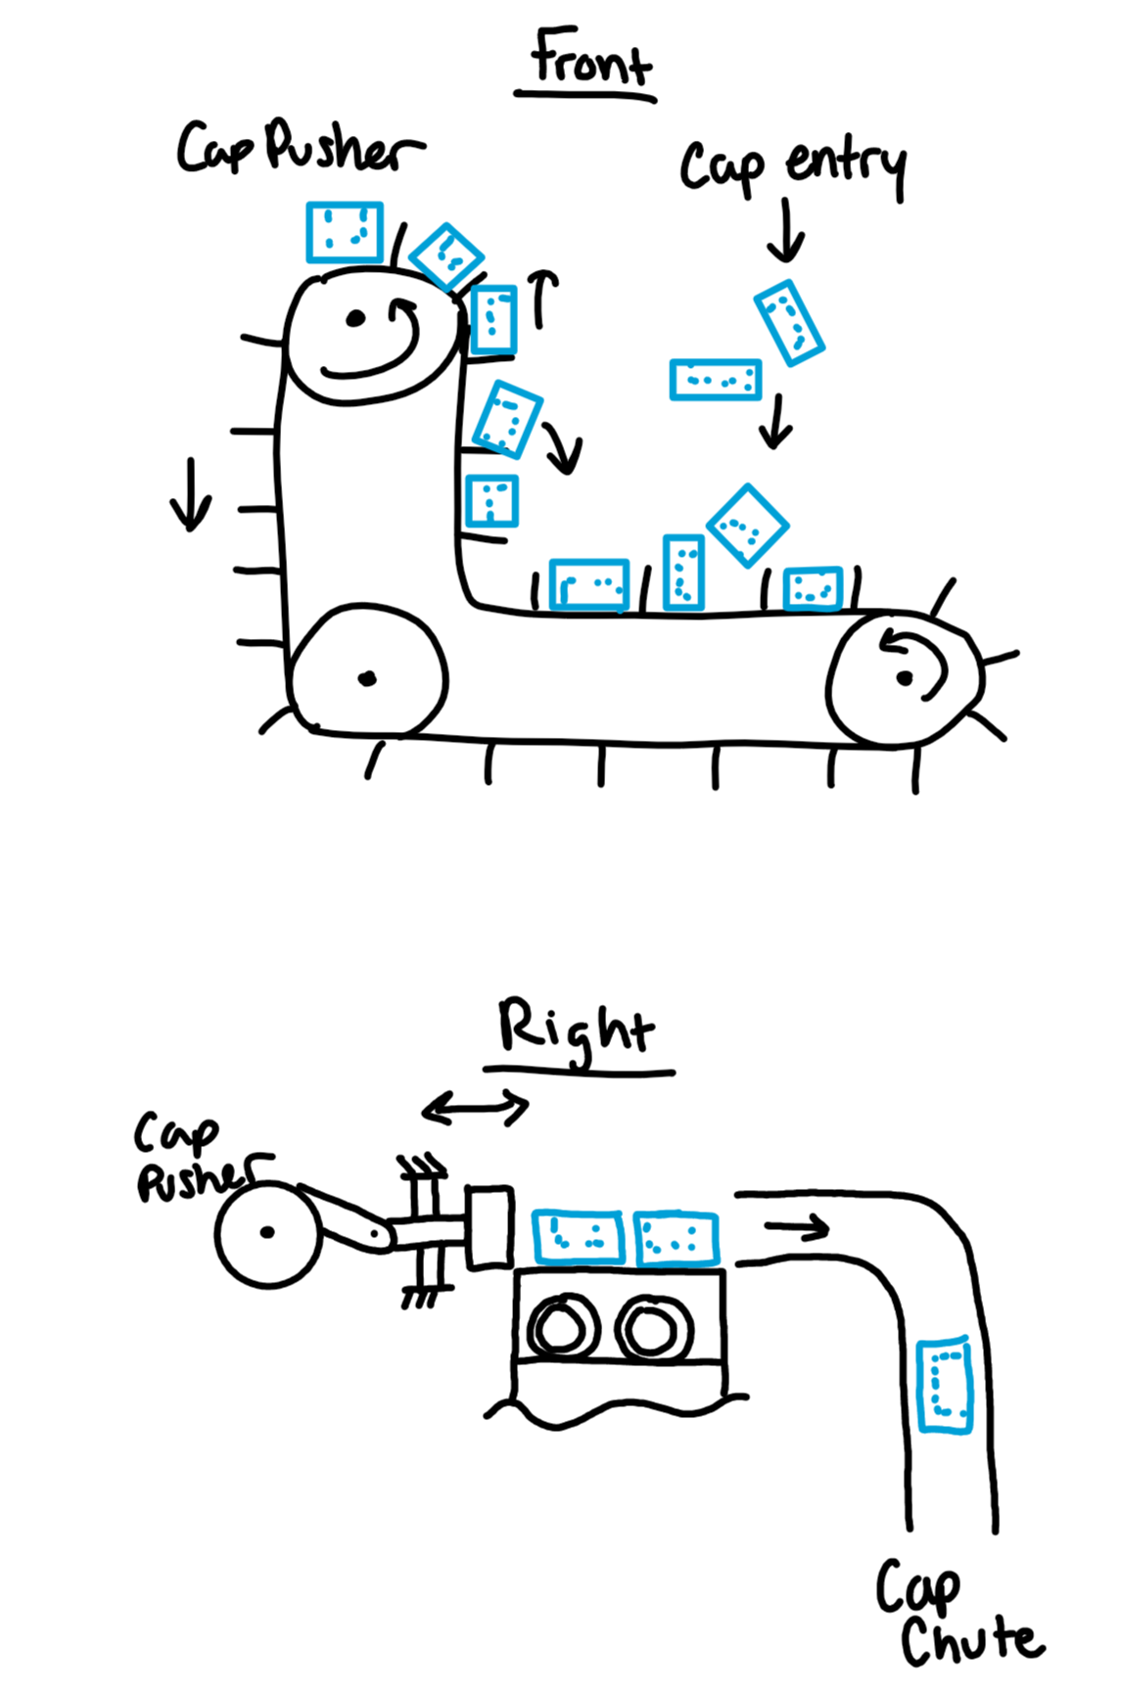
Concept Selection and Generation: Cap Descrambler
Concept | Vertical Conveyor Belt | Ultrasonic Descrambler | Center of Gravity | Rotary Descrambler
Automation | 4 | 3 | 3 | 3
Descrambling | 4 | 1 | 2 | 2
Speed | 5 | 2 | 1 | 2
Low Cost | 3 | 1 | 2 | 1
Totals | 16 | 7 | 8 | 8
Wi
Notes:
liv

Slide 7
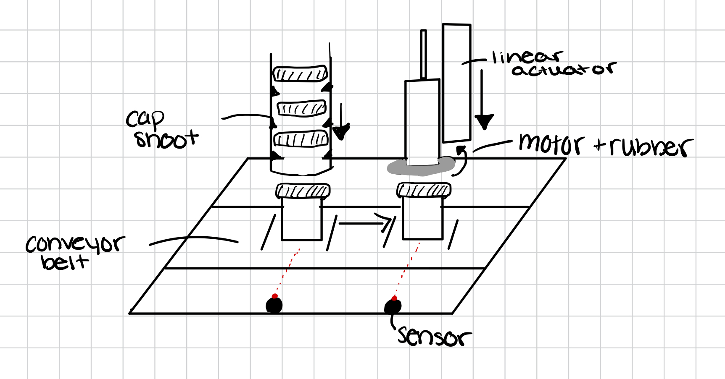
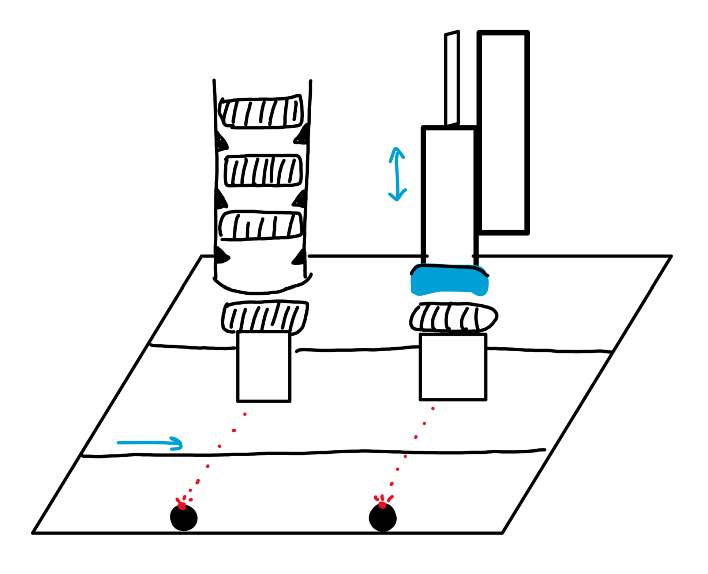
Concept Selection and Generation: Capping Station
Concept | Twister | Rotating Discs | Leading Lines
Compactness | 3 | 1 | 2
Capping | 3 | 2 | 1
Speed | 2 | 1 | 3
Low Cost | 3 | 1 | 2
Totals | 11 | 5 | 8
WiWWi
Notes:
liv

Slide 8
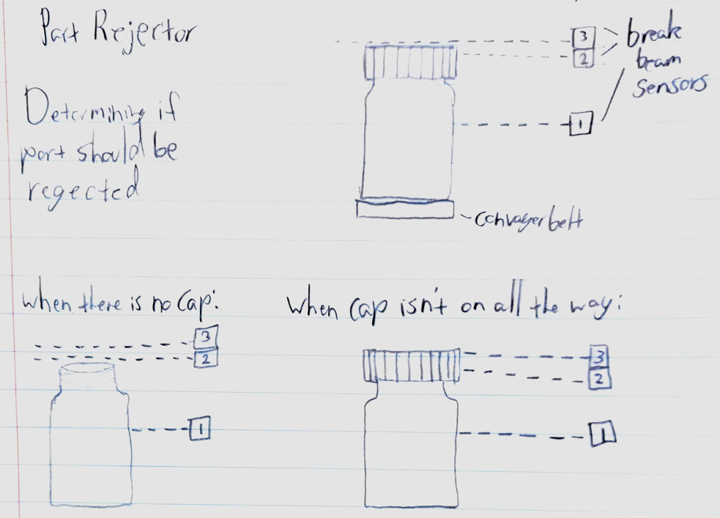
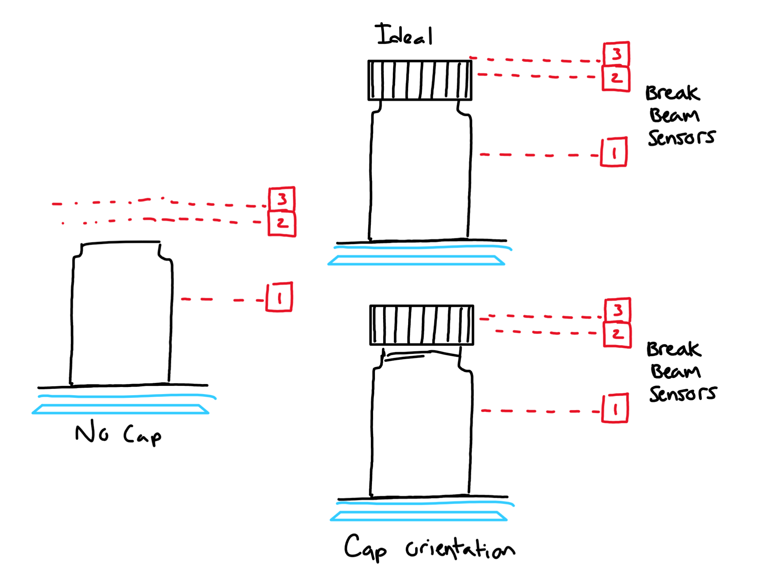
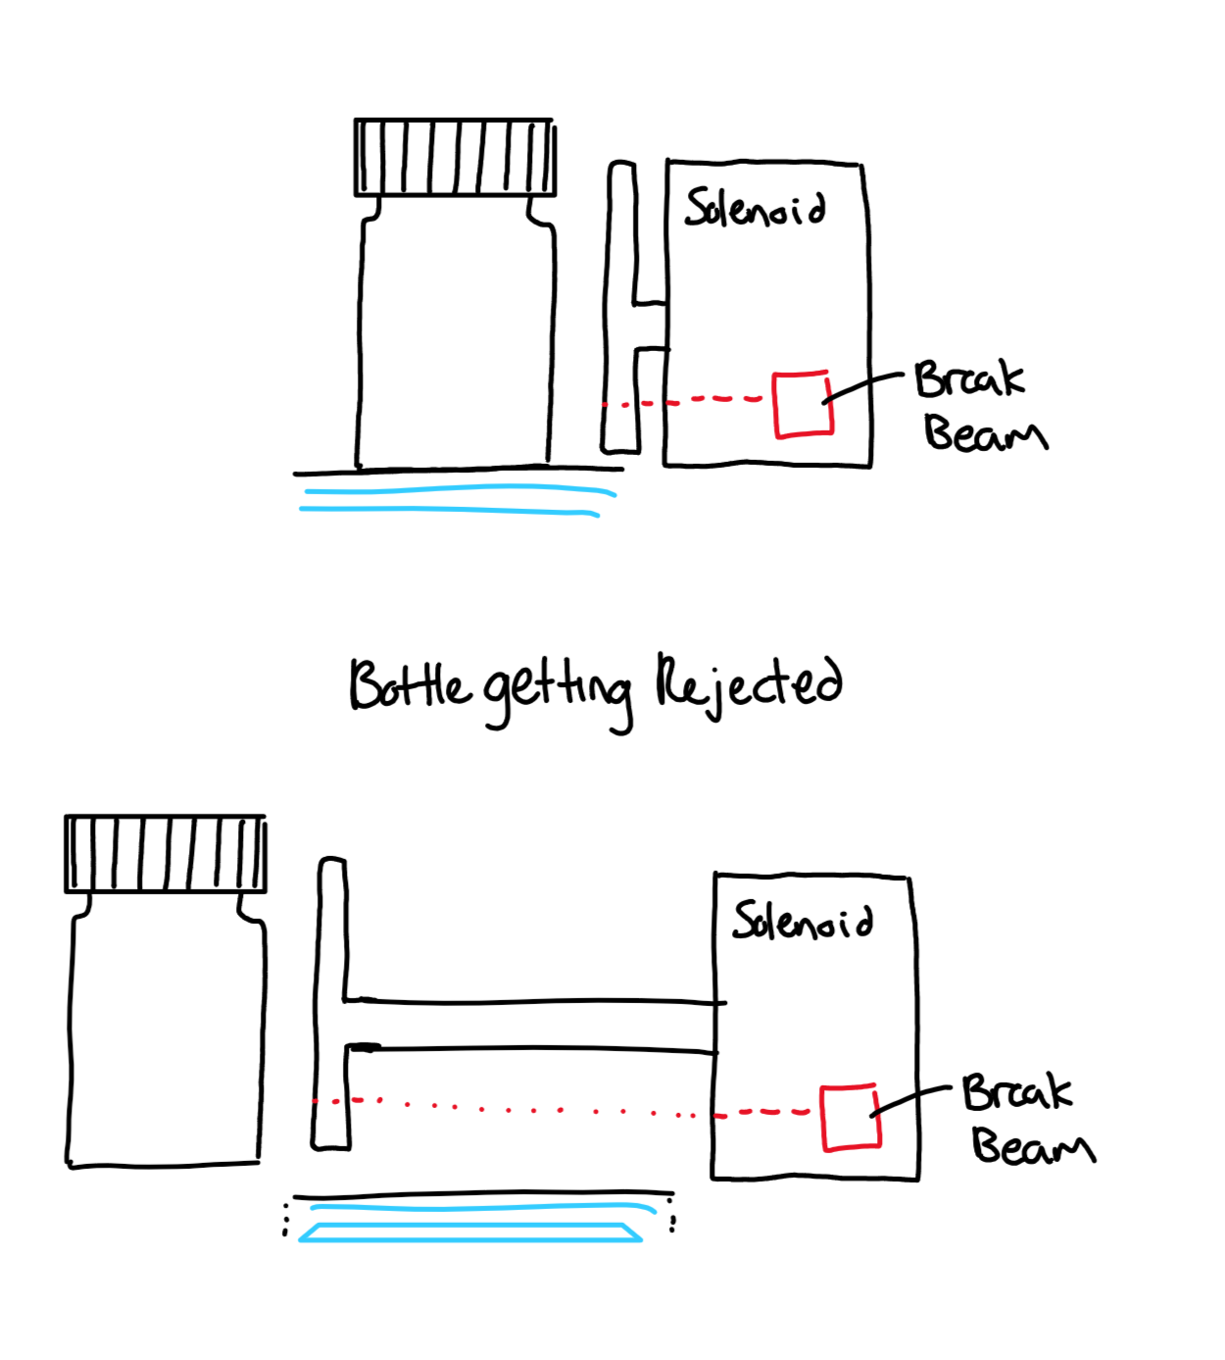
Concept Selection and Generation: Part Rejector
Concept | Break Beam | Solenoid | Vibration | Floor Removal | Pivot
Building Difficulty | 3 | 4 | 1 | 2 | 3
Rejection / Detection | 4 | 4 | 1 | 4 | 3
Speed | 5 | 5 | 2 | 3 | 2
Low Cost | 4 | 4 | 2 | 1 | 4
Totals | 16 | 17 | 6 | 10 | 12
WiWWi
Notes:
liv

Slide 9
Overview of Final Design
Caps enter at random orientations
Cap Descrambler
Bottle accepted from Front Station onto Conveyor belt
Rejected Bottles exit
Cap chute
Conveyor Belt feeds bottle into Rotary Table
Caps placed on bottle in correct orientation
Capping Mechanism
Cap Sensing
Part Rejector
Accepted Bottles exit
Notes:
david

Slide 10
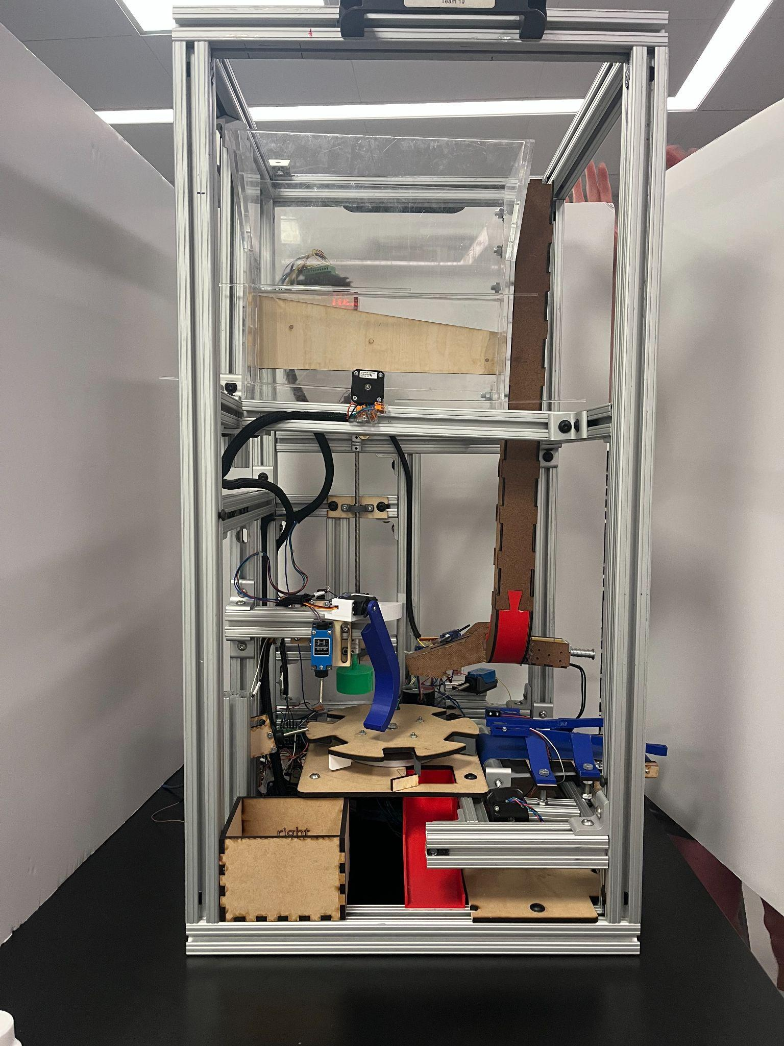
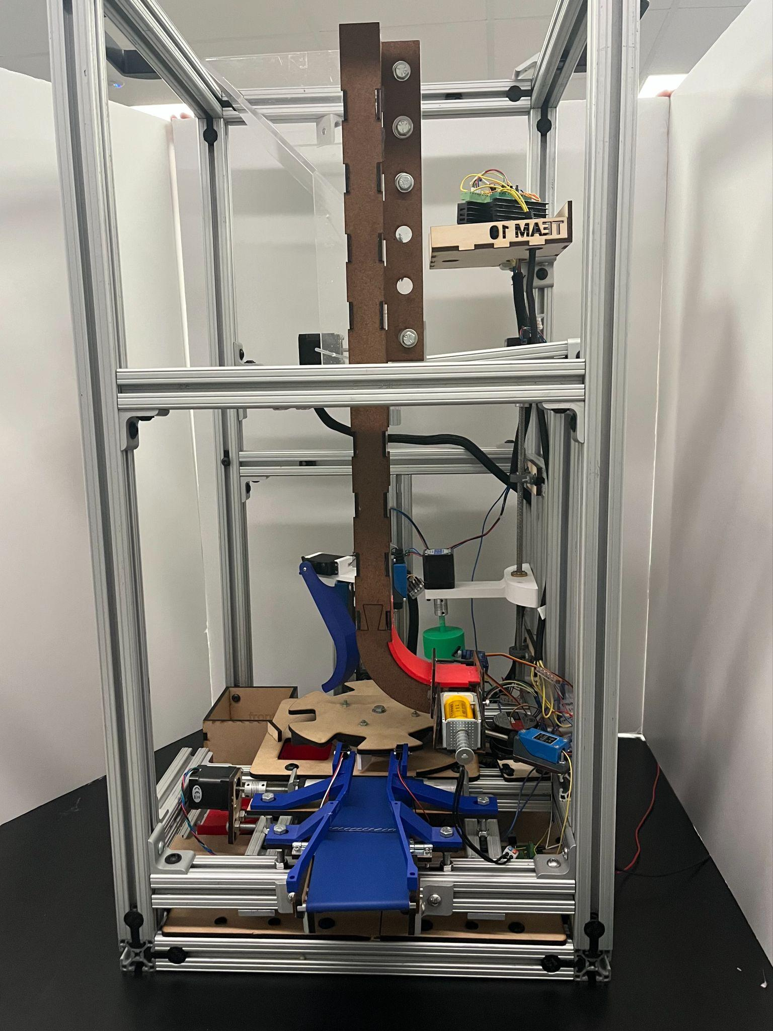
Overview of Final Design
Descrambler
Rejector Arm
Cap Tightening
Rotary Table
Cap Chute
Accepted Bottle Chute
Conveyor Belt (entrance)
Notes:
david

Slide 11

Full Automation

Slide 12
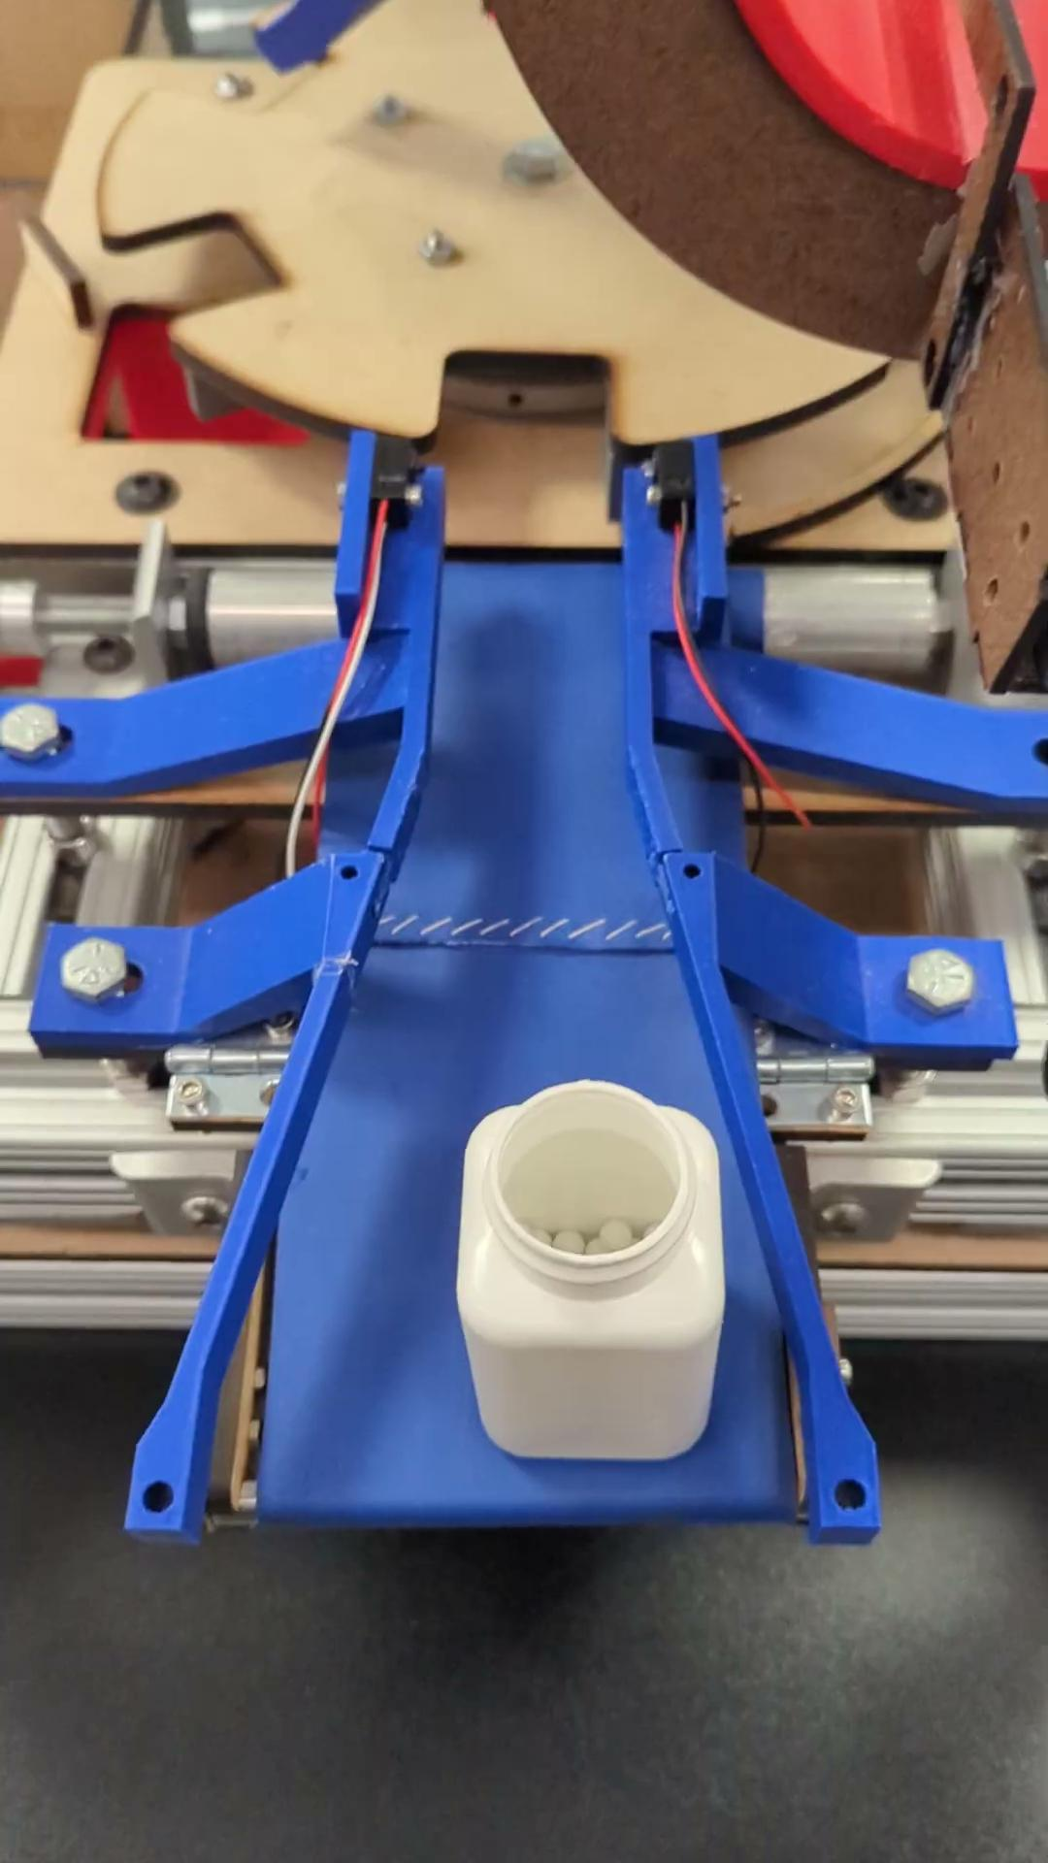
Bottle Acceptor
Bottles are transported from the front station using a conveyor belt.
Controlled by a single stepper motor.
Uses guide rails to move the bottles onto the rotary table.
Folds into the frame for transport and storage.
Possible Failure Points: rails fracturing, bottles jamming within the rails.
Notes:
Alex

Slide 13
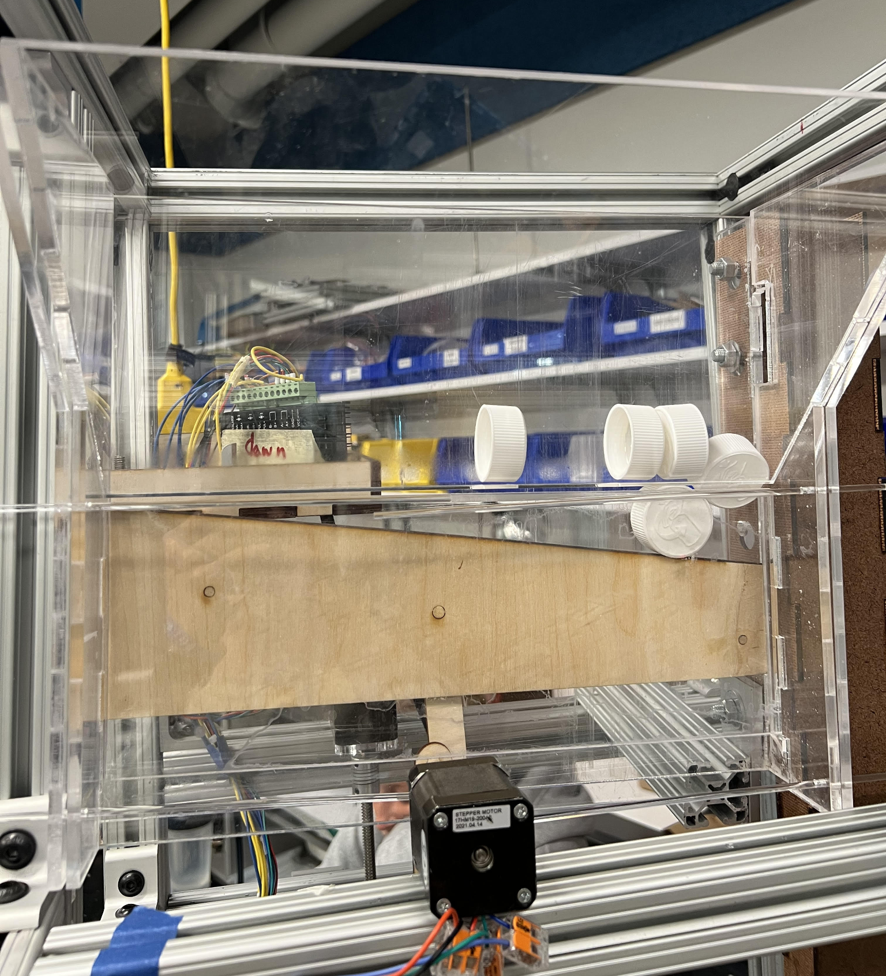
Cap Descrambler
The descrambler uses the center of gravity of the caps to force them into a single orientation.
Actuated by a crank-slider mechanism powered by a stepper motor.
Capable of descrambling 12 caps.
Possible Failure Points: shaft breaking loose, jamming, unable to descrambler caps in certain orientations.
Notes:
Mickey

Slide 14
Cap Descrambler Demonstration
Notes:
Mickey

Slide 15
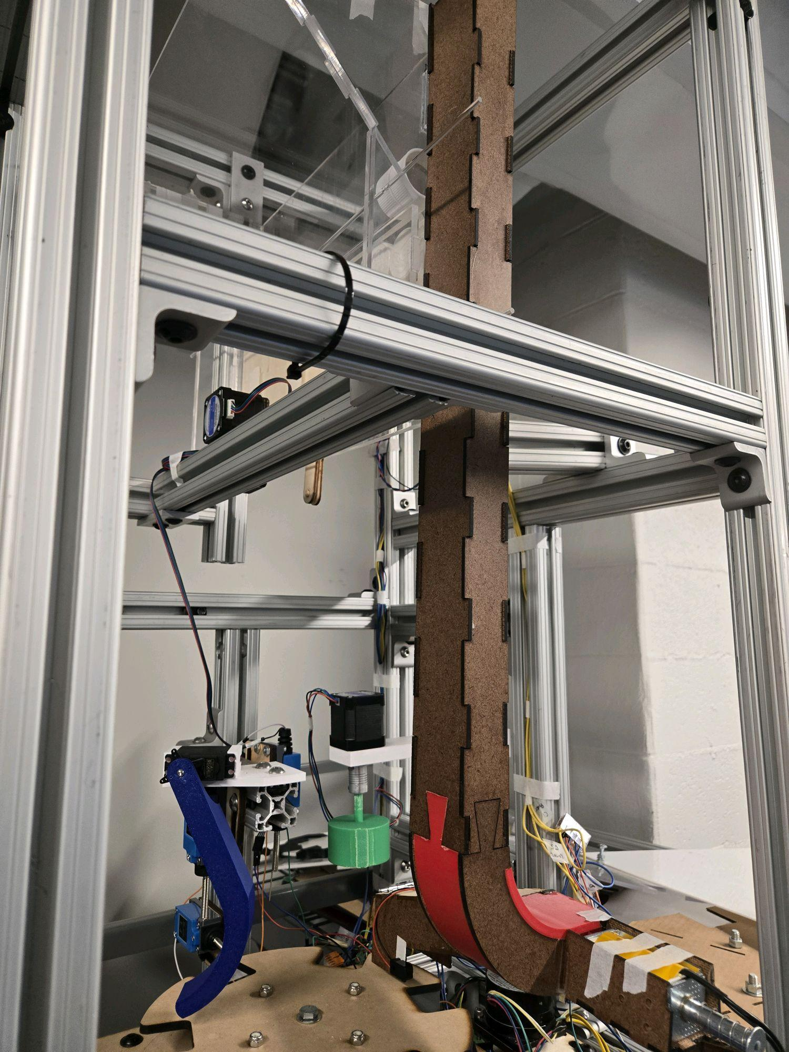
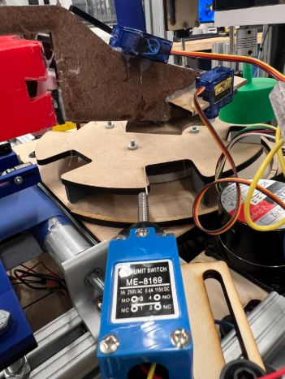
Cap Chute
Transports caps from the descrambler to the tops of the bottles.
Uses 12V solenoid and servo motor to place caps on one bottle at a time.
Bottle hits whisker sensor causing the solenoid to activate and servo to activate after a time delay
Possible Failure Points: low precision when placing caps, whisker sensor must placed very accurately.
Notes:
Alex

Slide 16
Cap Chute Demonstration
Notes:
Alex

Slide 17
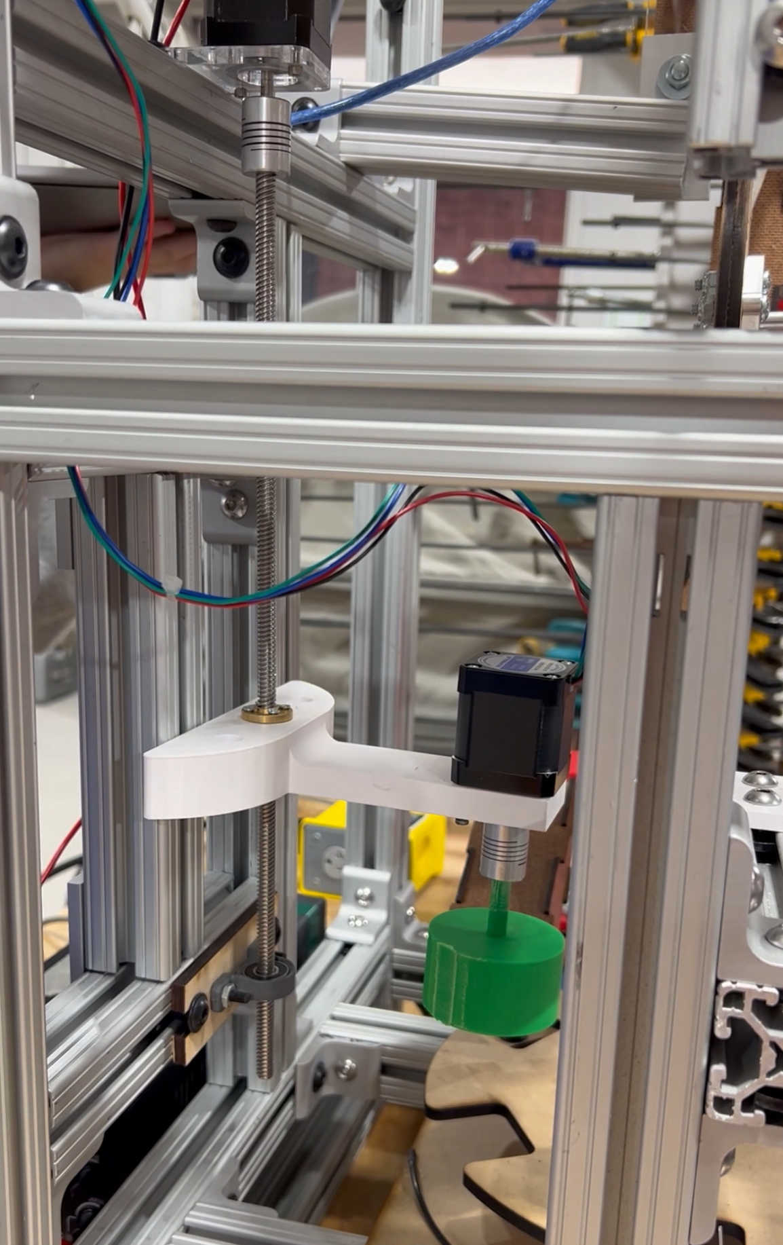
Cap Tightener
Actively uses friction to tighten caps. (Rubber insert)
When system is activated by the position of the rotary table:
  Lead screw lowers attachment 1 inch
  2nd Motor rotates 3 full turns
  Lead screw brings up attachment 1 inch
Possible Failure Points: jamming when bottles are out of position, must be properly positioned before activating
Notes:
emma

Slide 18
Cap Tightener Demonstration
Notes:
Emma

Slide 19
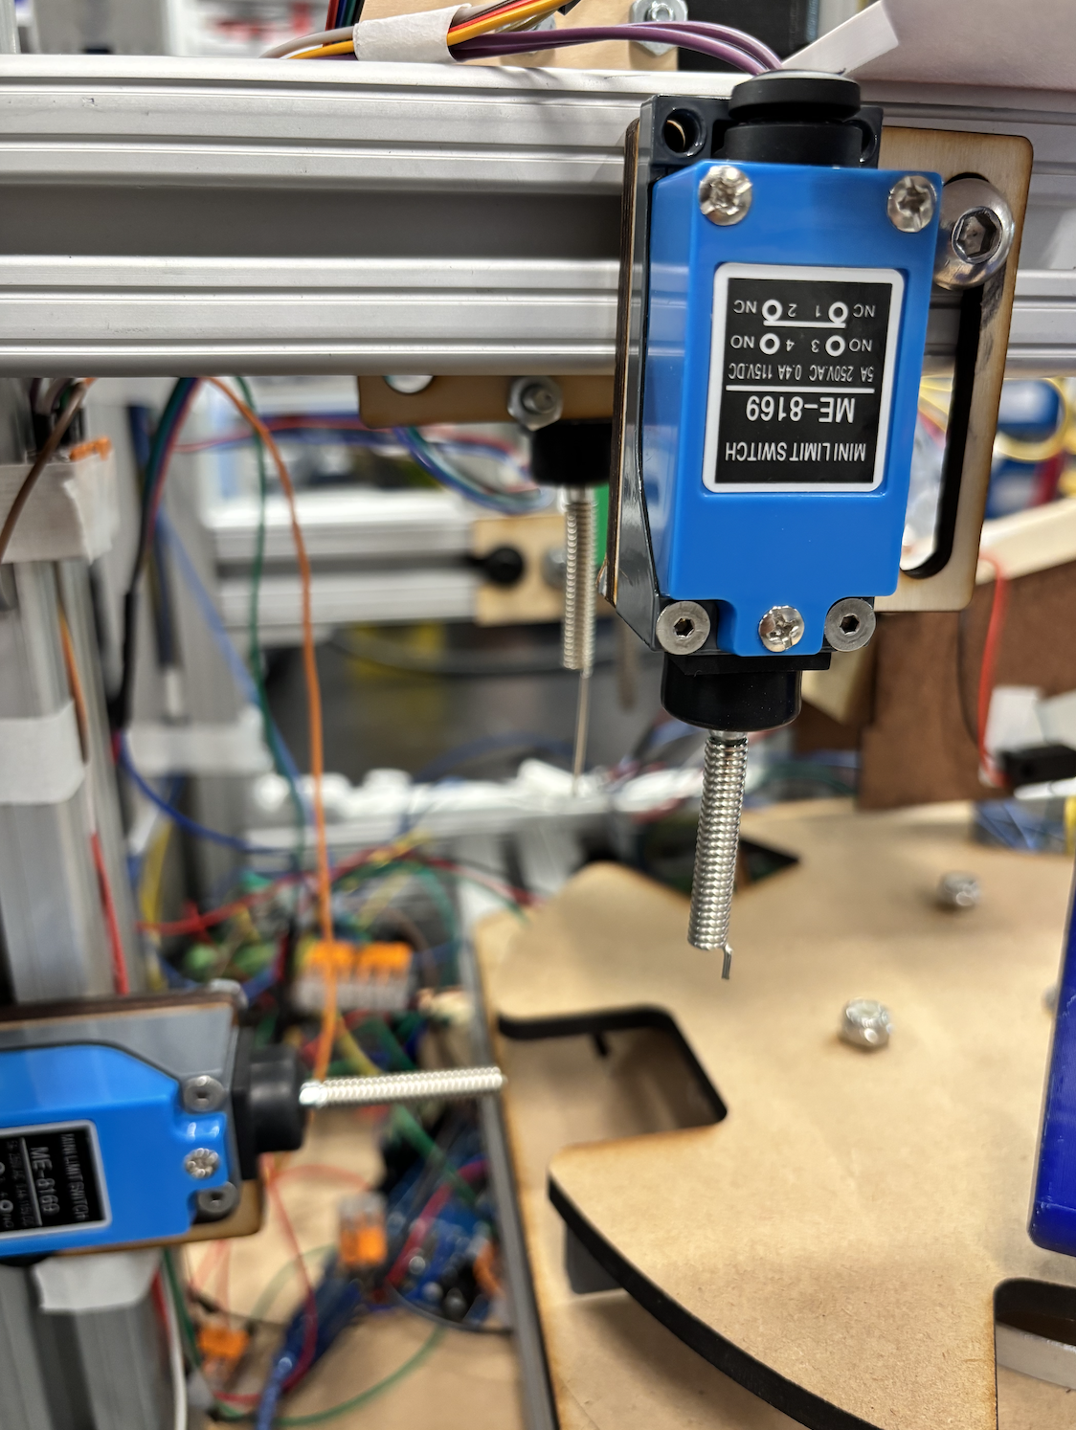
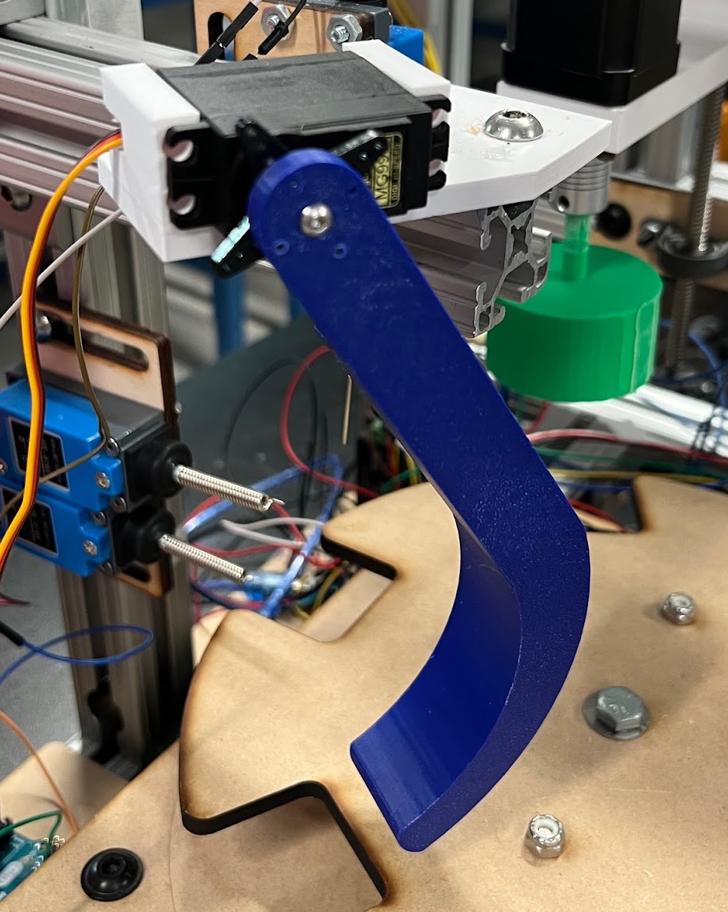
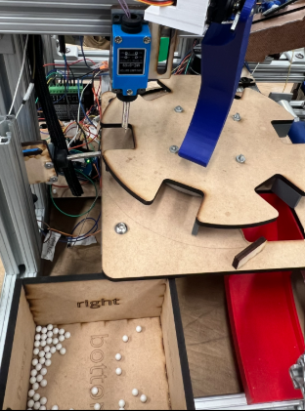
Part Rejector
Whisker sensors detect the presence and height of caps.
3D-printed arm powered by servo motor pushes unsatisfactory bottles into a discard bin at the following position.
Acceptable bottles are allowed to pass to the end chute.
Possible Failure Points: servo motor mounting fracture, occasional discard of acceptable bottles, whisker sensors cause resistance and disturb bottles.
Notes:
David

Slide 20
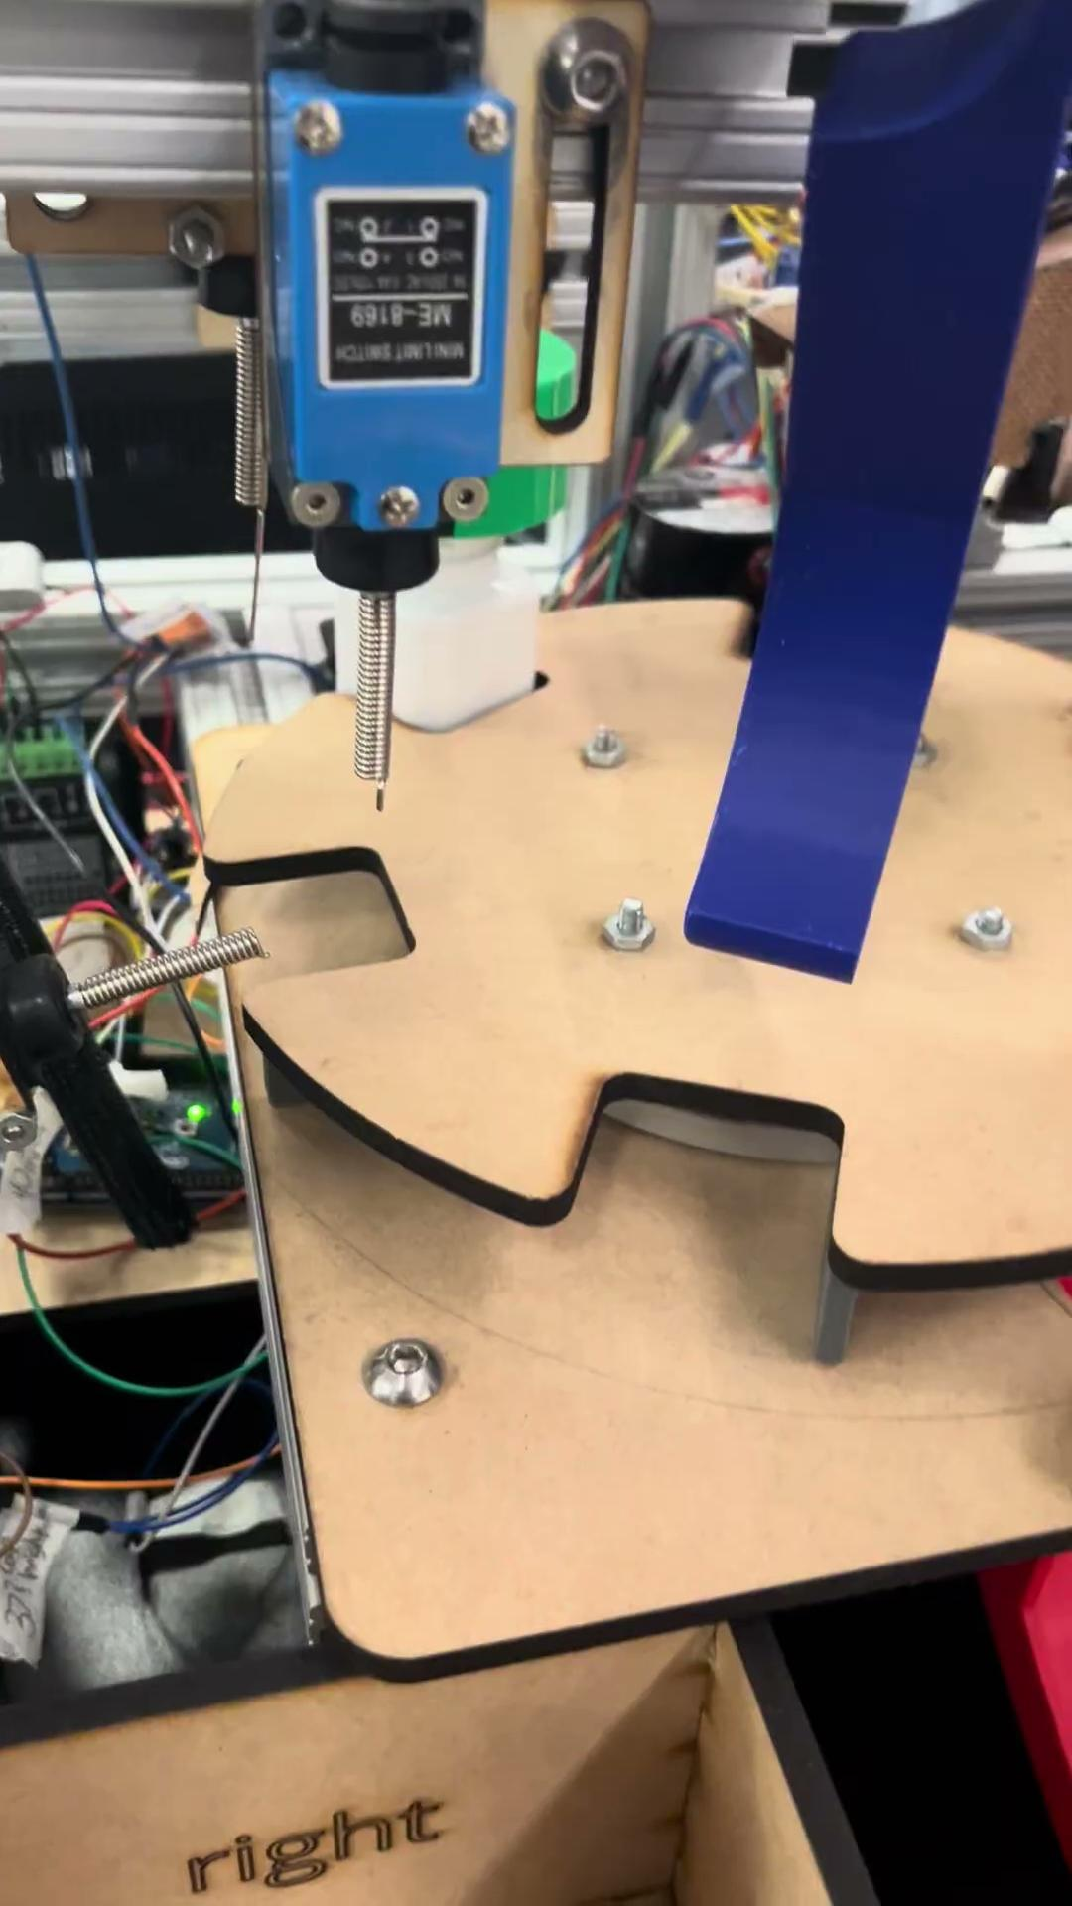
Part Rejector Demonstration
Accepted
Rejected
Notes:
David

Slide 21
Arduino Code
Code has been combined from all substations into one code.
100% automation with one arduino.
Emergency stop button added into the code for increased safety.
Each subsystem is in their own function and combined to the large loop for each trial.
The break beam triggers the start of each subsystem.
Notes:
emma

Slide 22
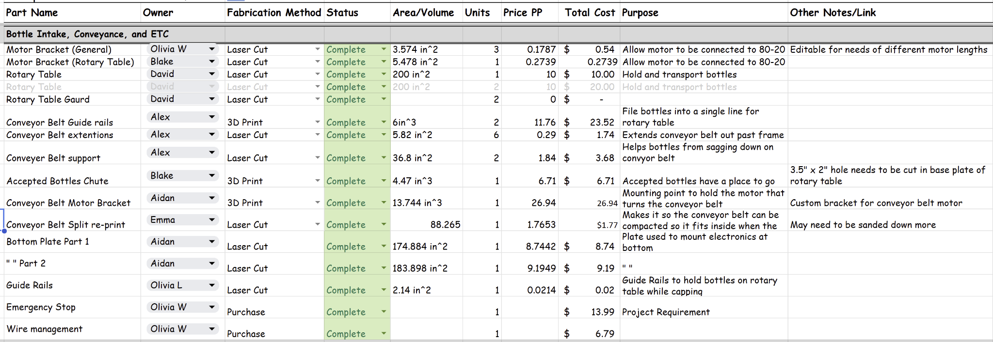
Bill of Materials
Notes:
liv

Slide 23
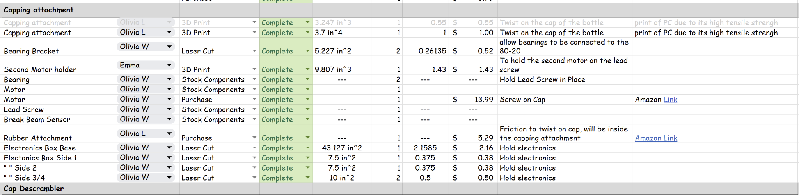
Bill of Materials
Notes:
liv

Slide 24
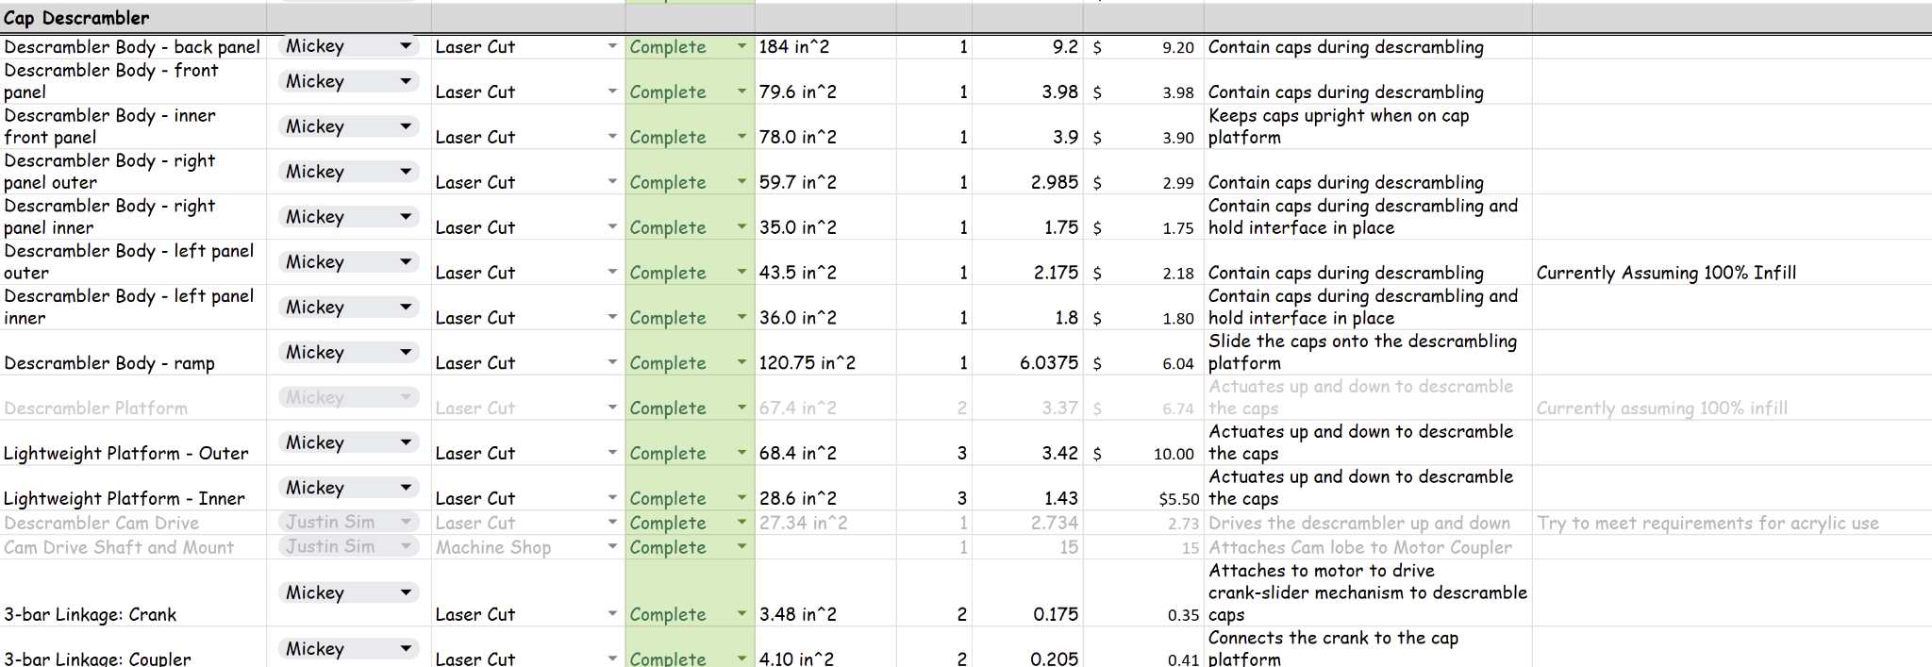
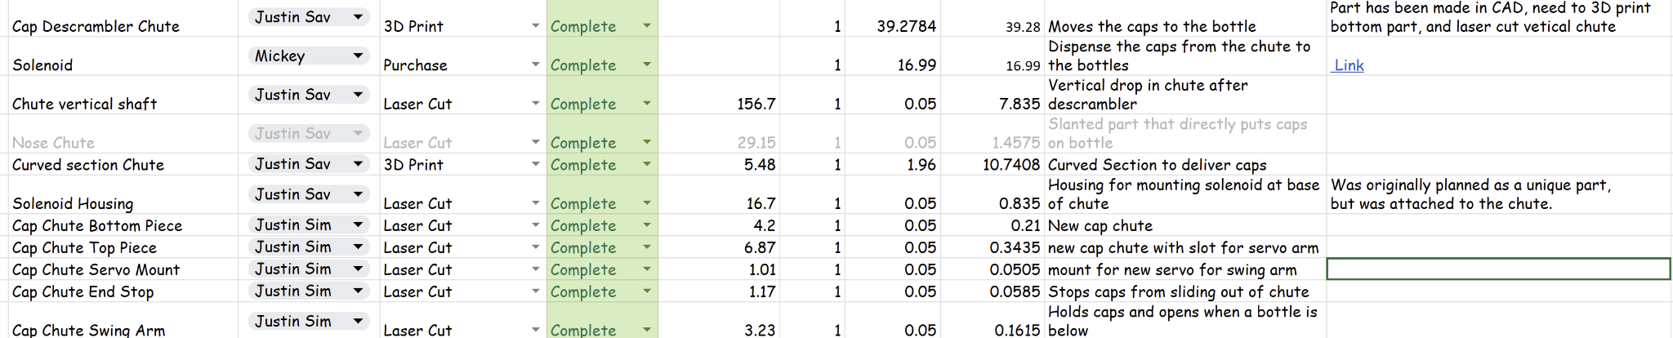
Bill of Materials
Notes:
liv

Slide 25
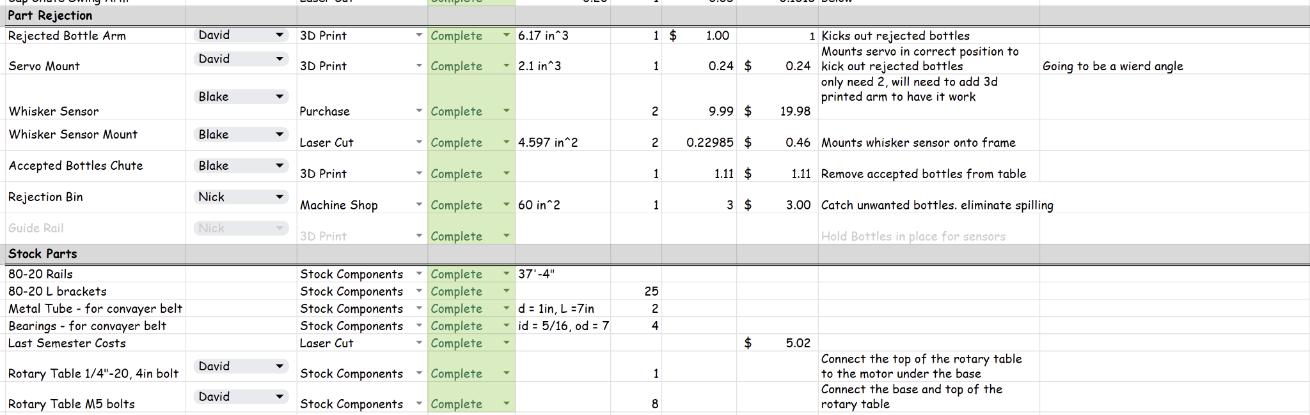
Bill of Materials
Notes:
liv

Slide 26
Budget
Currently Spent :
$341.42
Online Order: $77.03
Laser Cut: $133.88
3D Print: $113.00
Machine Shop: $18.00
Remaining:
$158.58
Cost of Unused Material:
$46.48
Notes:
liv

Slide 27
Project Management
Divide labor based on the team members’ strengths and areas needing improvement.
Organized communication through GroupMe messaging.
Regular team meeting once a week and subgroup meetings for specific tasks.
Documents are file-organized using Google Drive for live updates.
Shared commitment to clear communication when being late or absent.
Aim to finish assignments a few days before due dates.
Notes:
Emma

Slide 28
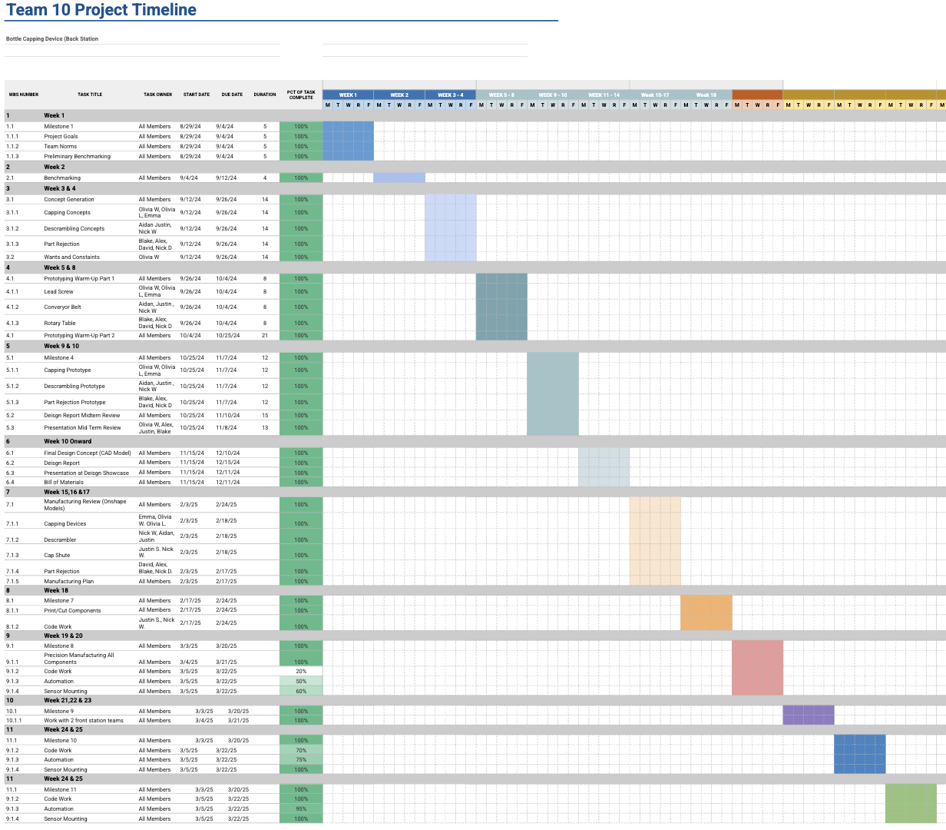

Project Timeline
Notes:
Emma

Slide 29
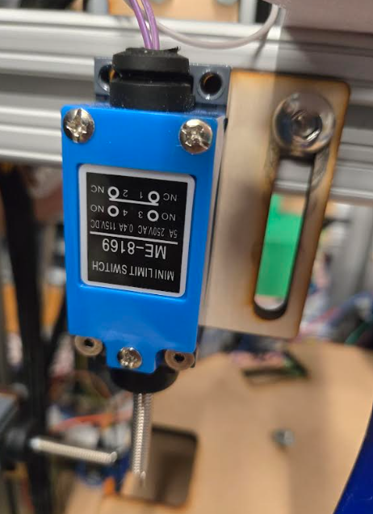
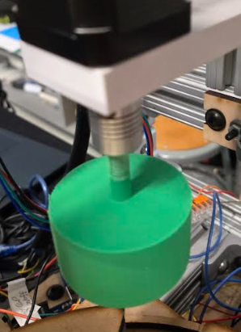
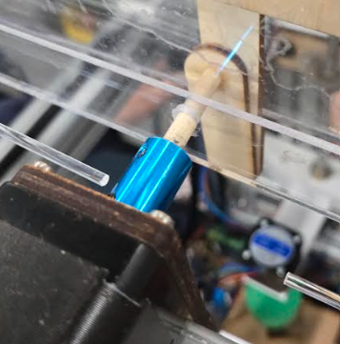
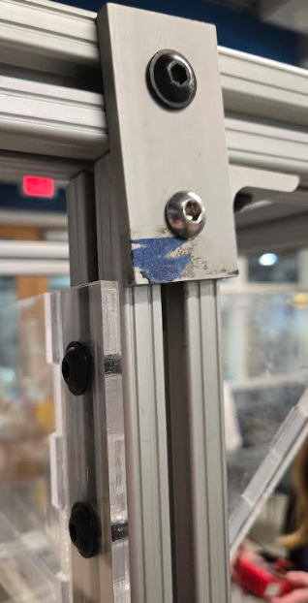
Mechanical Failure Analysis Overview
Whisker Sensor Bracket
Tightener Motor Shaft
Descrambler Motor Shaft
Descrambler Bracket
Notes:
MICKEY

Slide 30
Fatigue Life - Descrambler Motor Shaft
The motor shaft on the descrambler is made of a ¼in, 1.375in long wooden dowel.
The mass of the slider and the torque from the motor generate stress on the shaft.
The driving torque is 0.28 N-m, and the mass of the slider is 0.25 kg.
This generates a mean Von Mises stress of 11.2 MPa, and and amplitude of 8.14 MPa.
Yield factor of safety is 1.7, and infinite life factor of safety is 0.95 from Goodman criterion.
The shaft will not yield or fracture, but it’s life is finite.
Insufficient data on wood to calculate number of cycles to failure.
From the factor of safety, the lifetime is expected to be close to 1 million cycles.
Notes:
MICKEY

Slide 31
Completed Testing
MANUAL FILLING:
One person fills a bottle with exactly 30 pills
Puts cap on and tightens
Repeat for 12 bottles
RESULTS:
Average total time - 5:24
Average time per bottle - 0:28
AUTOMATED FILLING:
12 bottles are sent through back station
RESULTS:
Average total time - 2:30
Time for first bottle - 0:47
Rotation time - 0:10
Average time per bottle - 0:15
Notes:
David

Slide 32
Validation of Constraints
Want/ Constraint | Metric | Target Value | Measured Value | Pass/Fail
Bottle Handoff | # Bottles Collected successfully | 12 Bottles collected successfully | Maximum = 12, Average = 12 | Pass
Cap Descrambler | # Caps Descrambled successfully | 12 Caps successfully descrambled | Maximum = 12, Average = 4 | Fail
Capping | # Caps successfully capped | 12 Caps successfully capped | Placed on Bottle = 1 Tightened = 12 | Fail Pass
Part Rejector | Must detect if cap is screwed on the bottle correctly, if not the bottle must be removed from the assembly line | No operator intervention is needed as well as must detect EVERY cap that is not screwed on properly | Successfully Rejected Maximum = 12, Average = 11 Successfully Allowed Through: Maximum = 12, Average = 11 | Pass
 | Height of bottle | Cap must be within a certain range to not be rejected.
Automation | Must be fully automated | No operator intervention is needed while each station is functioning | Can be completed without intervention | Pass
Speed of ‘Back Station’ Process | Time | 1/2X manual completion of process. | Process Time = 40 seconds 1/2X time of manual process | Pass
Compact | Dimensions of all components when not in use | All materials fit in 26” x 20” x 40” storage area. | Volume = 26” x 20” x 40” | Pass
Notes:
David

Slide 33
Validation of Wants
Priority | Want/ Constraint | Metric | Target Value | Measured Value | Pass/Fail
1 | Safety | OSHA Transport requirements | Fits within OSHA standards (29 CFR 1910.147, 212, 217) | Complies with OSHA Standards | Pass
 |  | ISO and ASTM safety Standards | Fits within the given standards (ASTM E3106, etc.) | Complies with ASTM Standards | Pass
2 | Pill Spillage | Number of pills leaving bottles during ‘Back Station’ process | Minimal error +/- 1 pill from nominal value | 0 pills spilled during process | Pass
3 | Minimize Cost | Cost ($) | 20% less than given budget ($400) | $341 Spent | Pass
4 | Minimal Product Waste | Product waste (lbs) | < 5 lbs Product waste | 3 lbs of Product Waste | Pass
5 | Ease of set up | # People Required to Set up | 2 people | Requires at least 2 team members to operate | Pass
Notes:
Justin
1910.147 - Hazardous Lockout (emergency stop button to cut off power)
1910.212 - Needs to have guards for moving/spinning parts
1910.217 - Guards around linear articulating components (solenoid housing)
ASTM F2885 - Guide for Science-Based and Risk-Based Cleaning Process Development and Validation.
Describes how to apply quality risk management (ICH Q9) to develop, qualify, and monitor cleaning processes, ensuring removal of API, excipients, and cleaning agents

Slide 34
Proposed Improvements
Update Code
  Most issues with cap chute and part rejector came from the code
  Descrambler and rotary table can be made more consistent
    Use gears instead of a belt
Revise or replace cap chute
  Add more support to prevent vibrations
  Replace trap-door with a more precise mechanism
Replace wooden/hardboard parts with metal, plastic, or acrylic
Replace descrambler motor to increase torque
Notes:
Justin

Slide 35
Acknowledgments:
Professor Adam Wickenheiser
Omega Design
Norwalt Design
Alex Abrams
Design Studio Staff and TAs
Thank you!
Notes:
Justin

